Slide 1
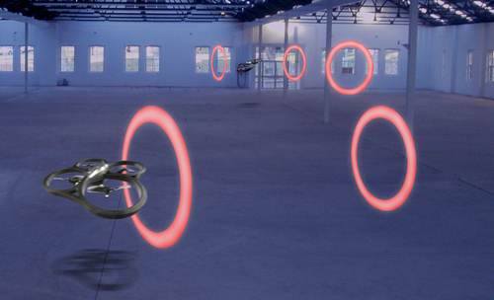
Concept 1: Vliegend object

Slide 2
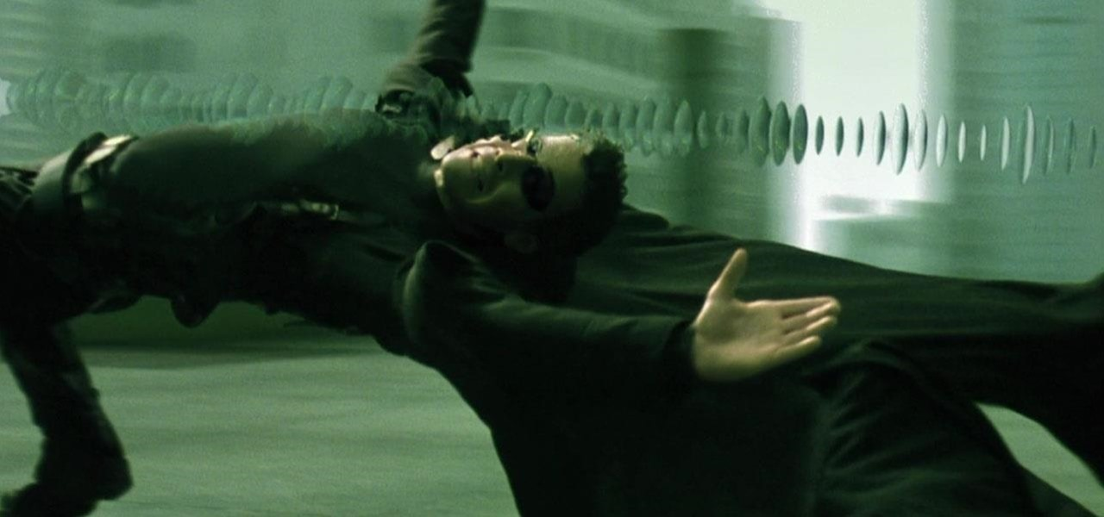
Concept 2: Bullet time

Slide 3
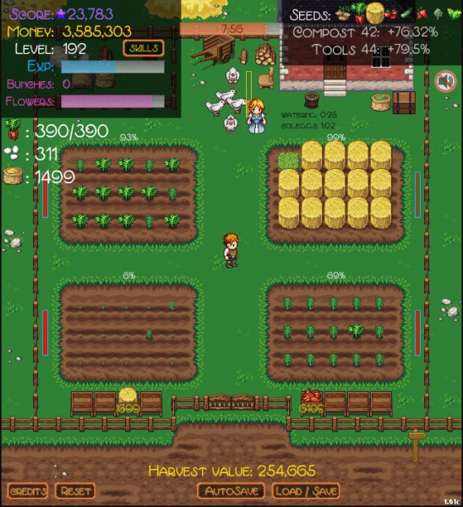
Concept 3: Idle game

